Slide 1
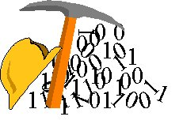
CSCS455 Data Mining and Data Warehousing Introduction

Slide 2
Course Information
Instructor: Ayesha Khan
Email: ayeshakhan@fccollege.edu.pk
Office: S-311
Office Hours: Office Door
Text Book: Data Mining – Concept and Techniques
Jiawei Han and Micheline Kamber (SECOND
EDITION)
Reference Book: Introduction to Data Mining with Case
Studies G.K.Gupta
Data Mining – Principles & Application
S Kumar, E Reddy and J S Kallimani

Slide 3
Tentative Grading
Assignments | 10
Quizzes | 15
Project | 15
Midterm | 20
Final | 35
Class Participation | 5
Total | 100

Slide 4
Policies
Quizzes
Quizzes can be announced or surprise
Sharing
Copying is not allowed for assignments. Discussions are encouraged; however, you must submit your own work.
Violators would be reported to Disciplinary Committee or face mark reduction penalties
Plagiarism
Do NOT pass someone else’s work as your own! Write in your own words and cite the reference if you use someone else’s material.

Slide 5
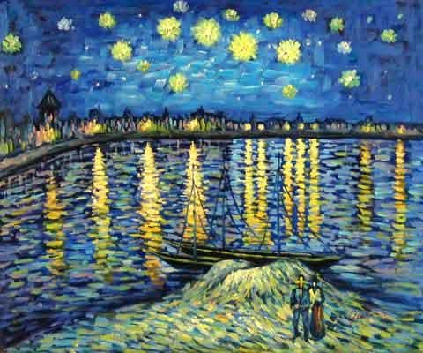
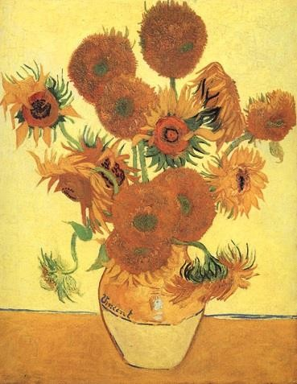
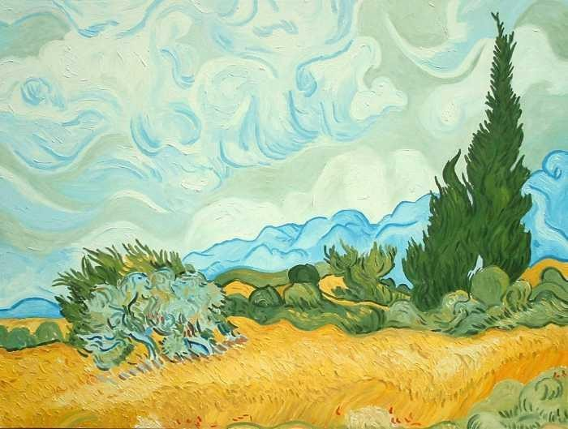
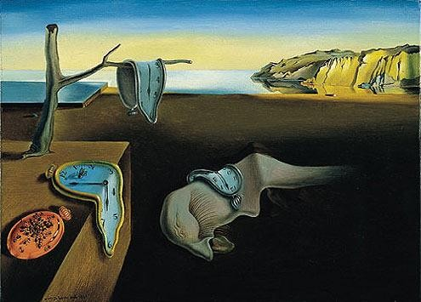

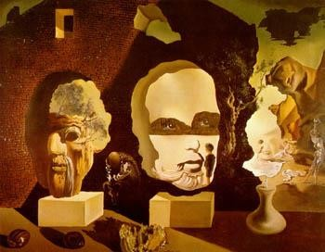
Paintings by two different painters
5
Notes:
Top row Vincet fongo
Second row Salvador dali

Slide 6
Who’s painting is this?
6

Slide 7

And this?
learning from data for generalization to unseen cases
7

Slide 8
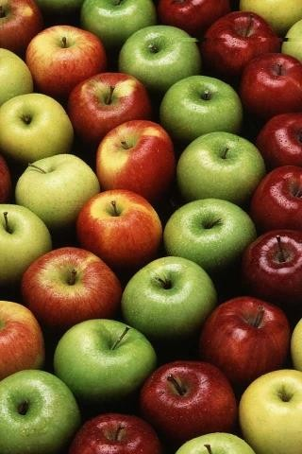
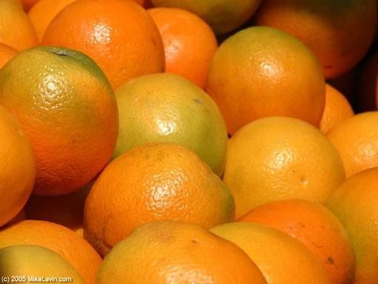
Apples
Oranges

Slide 9
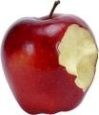
What is this?

Slide 10
How many categories (clusters) are there?

Slide 11
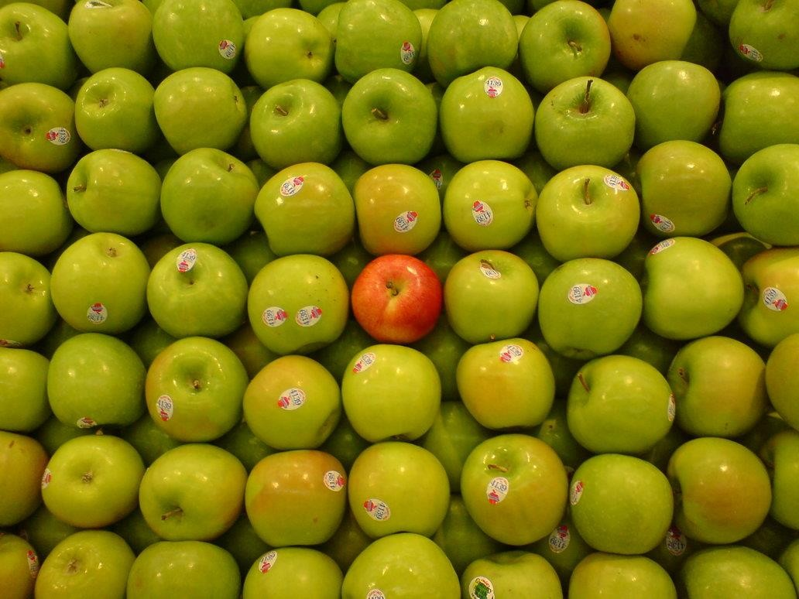
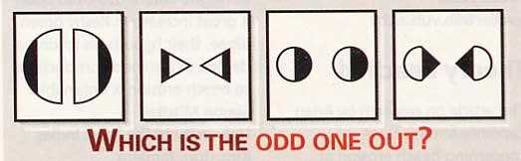
Find the odd one out!
Notes:
Differnet definations
- second has triangles that’s why odd
- third has black color on same sides
- first as its bigger

Slide 12
Predict the series
1,1,2,3,5,8,13,…
Notes:
21

Slide 13
Question?
Consider the vectors
– X₁=[1 2 1 4]^{T}
– X₂=[2 4 2 4]^{T}
– X₃=[0 0 0 4]^{T}
– X₄=[3 6 3 4]^{T}
– X₅=[4 8 4 4]^{T}
To store each vector, how many dimensions (or variables) do we need?
Notes:
all vectors have last value as 4 which is same
can we do better ?
first and third colo of all vectors is the same 1 1, 2 2, 1 0, 3 3, 4 4
more better ?
second coloum is first col x2
We have analyzed the data or patterns in data to get reduced representaion of data. Diemnsionality Reduction

Slide 14

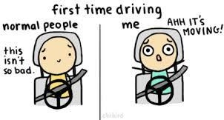
Learning to drive
Notes:
you do good you get benefit
you do bad you get penalty
Reinforcement learning

Slide 15
Questions
How were you able to recognize that the object shown was indeed an apple?
How were you able to discriminate between the
paintings from two different painters?
How were you able to find out the different types of apples in the picture?
How did you manage to find the next number in
the series?
How were you able to find which dimension was redundant?
How were you able to find the odd one out?
Learning to drive / write?
Classification
Classification
Clustering
Regression
Dimensionality Reduction
Anomaly Detection
Reinforcement learning

Slide 16
Definitions
Computers are .
Dumb
Making a machine (computer) perform the same tasks which you have just done is called
Artificial Intelligence
If you make a computer learn to do these tasks using existing data, then this is called
Machine Learning (learning from data)
Mining for patterns in data (for understanding it better and making predictions) is
Data Mining
Solving a machine learning task using a deep layered network of artificial models of
biological neurons (artificial neural network), is called _
Deep Learning (Learning from data with neural modeling)
Notes:
Diff between AI and ML

Slide 17

Well Humans learn, don’t they?
Of course!
In many many ways!!
Instruction based learning
Rote Learning
Informal Learning
Active Learning
Enculturation
Experience based learning
And we have achieved great things with this!!

Slide 18
Why do we need computers?
…ATTCGAGGATTACACCGTAAGAAATTT…
…ATCGCCTGATTACATATATACCGTTGG…
….AGATTAAATCGTTCGATTCACATTGAC
Deduction vs. Induction Reasoning
High dimensions
Required Reading
– Halevy, Alon, Peter Norvig, and Fernando Pereira. “The Unreasonable Effectiveness of Data.” IEEE Intelligent Systems, 2009.

Slide 19
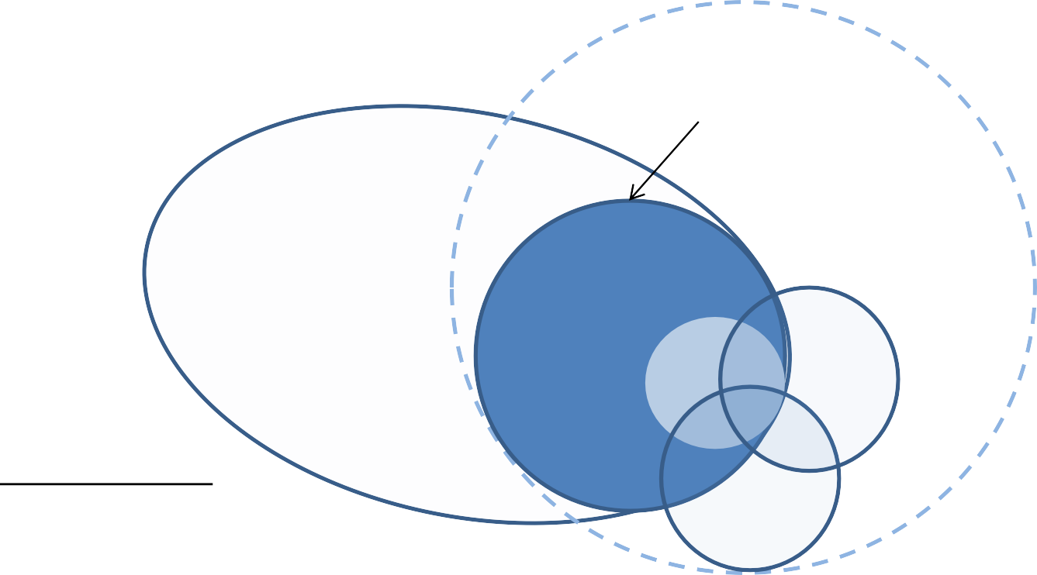
Machine Learning
A unique junction of computer science, applied mathematics statistics and the world!
AI
Machine Learning
The Machine Learning Centric View of AI (not to scale)
Data Science (aka Big Data!)
Data Mining
CI
Related Areas Statistics Linear Algebra
Calculus, Optimization Techniques High Performance Computing
Algorithms, Data structures and Programming
PR
Machine Learning is the Construction of algorithms that can learn from data to “explain” the data and make predictions
Information Retrieval, NLP, Computer Vision, Signal Analysis

Slide 20
Course Description
Week1 | Data Mining Intro – Data – Chap 1 and Chap 2
Week2 | Data Preprocessing Chap 3 – PCA – FSS
Week3 | Classification Basics, DT Basics Attribute Selection Measures Tree Pruning Scalability and DT. Chap 8. Quiz1 - Preprocessing
Week4 | Bayes Classification Rule Based Classification Model Evaluation and Selection. Chap 8
Week5 | Improve Classification Ensemble Bagging Boosting Random Forest Bayesian Belief Quiz2 – Classification so Far
Week6 | NN SVM KNN Chap 9
Week7 | GA Fuzzy Chap 9.6 Quiz 3 – Rest of Classification
Week8 | Midterm

Slide 21
Week9 | Proposal Presentation Clustering Basics Kmean Kmediod. Chap 10
Week10 | Hierarichal Agglomerative vs Divisive – Distance Measure Agglomerative BIRCH Density Based Chap 10
Week11 | Grid Based Cobweb Evaluation Chap 10 Quiz 4 - Clustering
Week12 | Outlier Detection
Week13 | Association Rule Mining FP Growth
Week14 | Application
Week15 | Project Presentation. Quiz 5- ARM and Rest of Clustering

Slide 22
Introduction
Nowadays,
storing data on computers is cheap
transferring data between computers is fast
small and cheap devices can collect a lot of data such as smartphones and other sensors

Slide 23
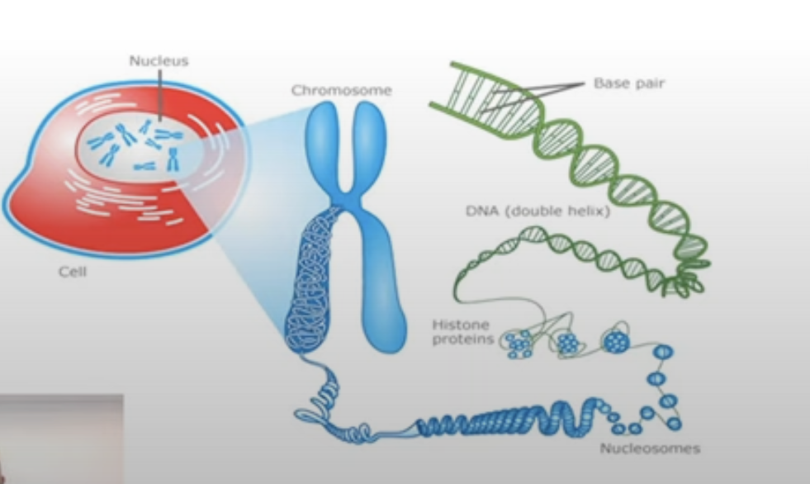
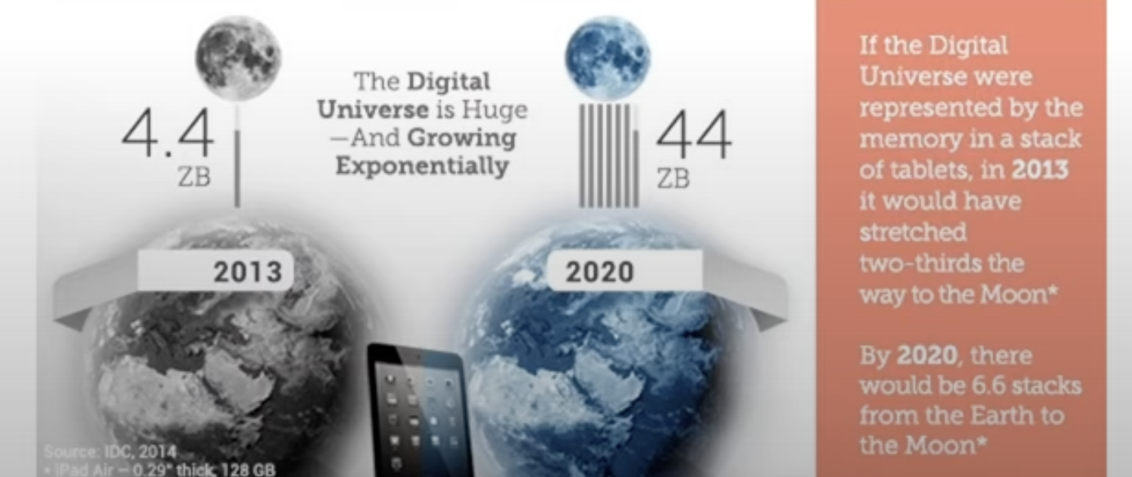
Data, Big Data and Data Science
We are going through an age of “Big Data”
Humans are the only biological entity that can store more data outside its body than inside it.
Notes:
writing and storing your memory could be called transfer of data

Slide 24
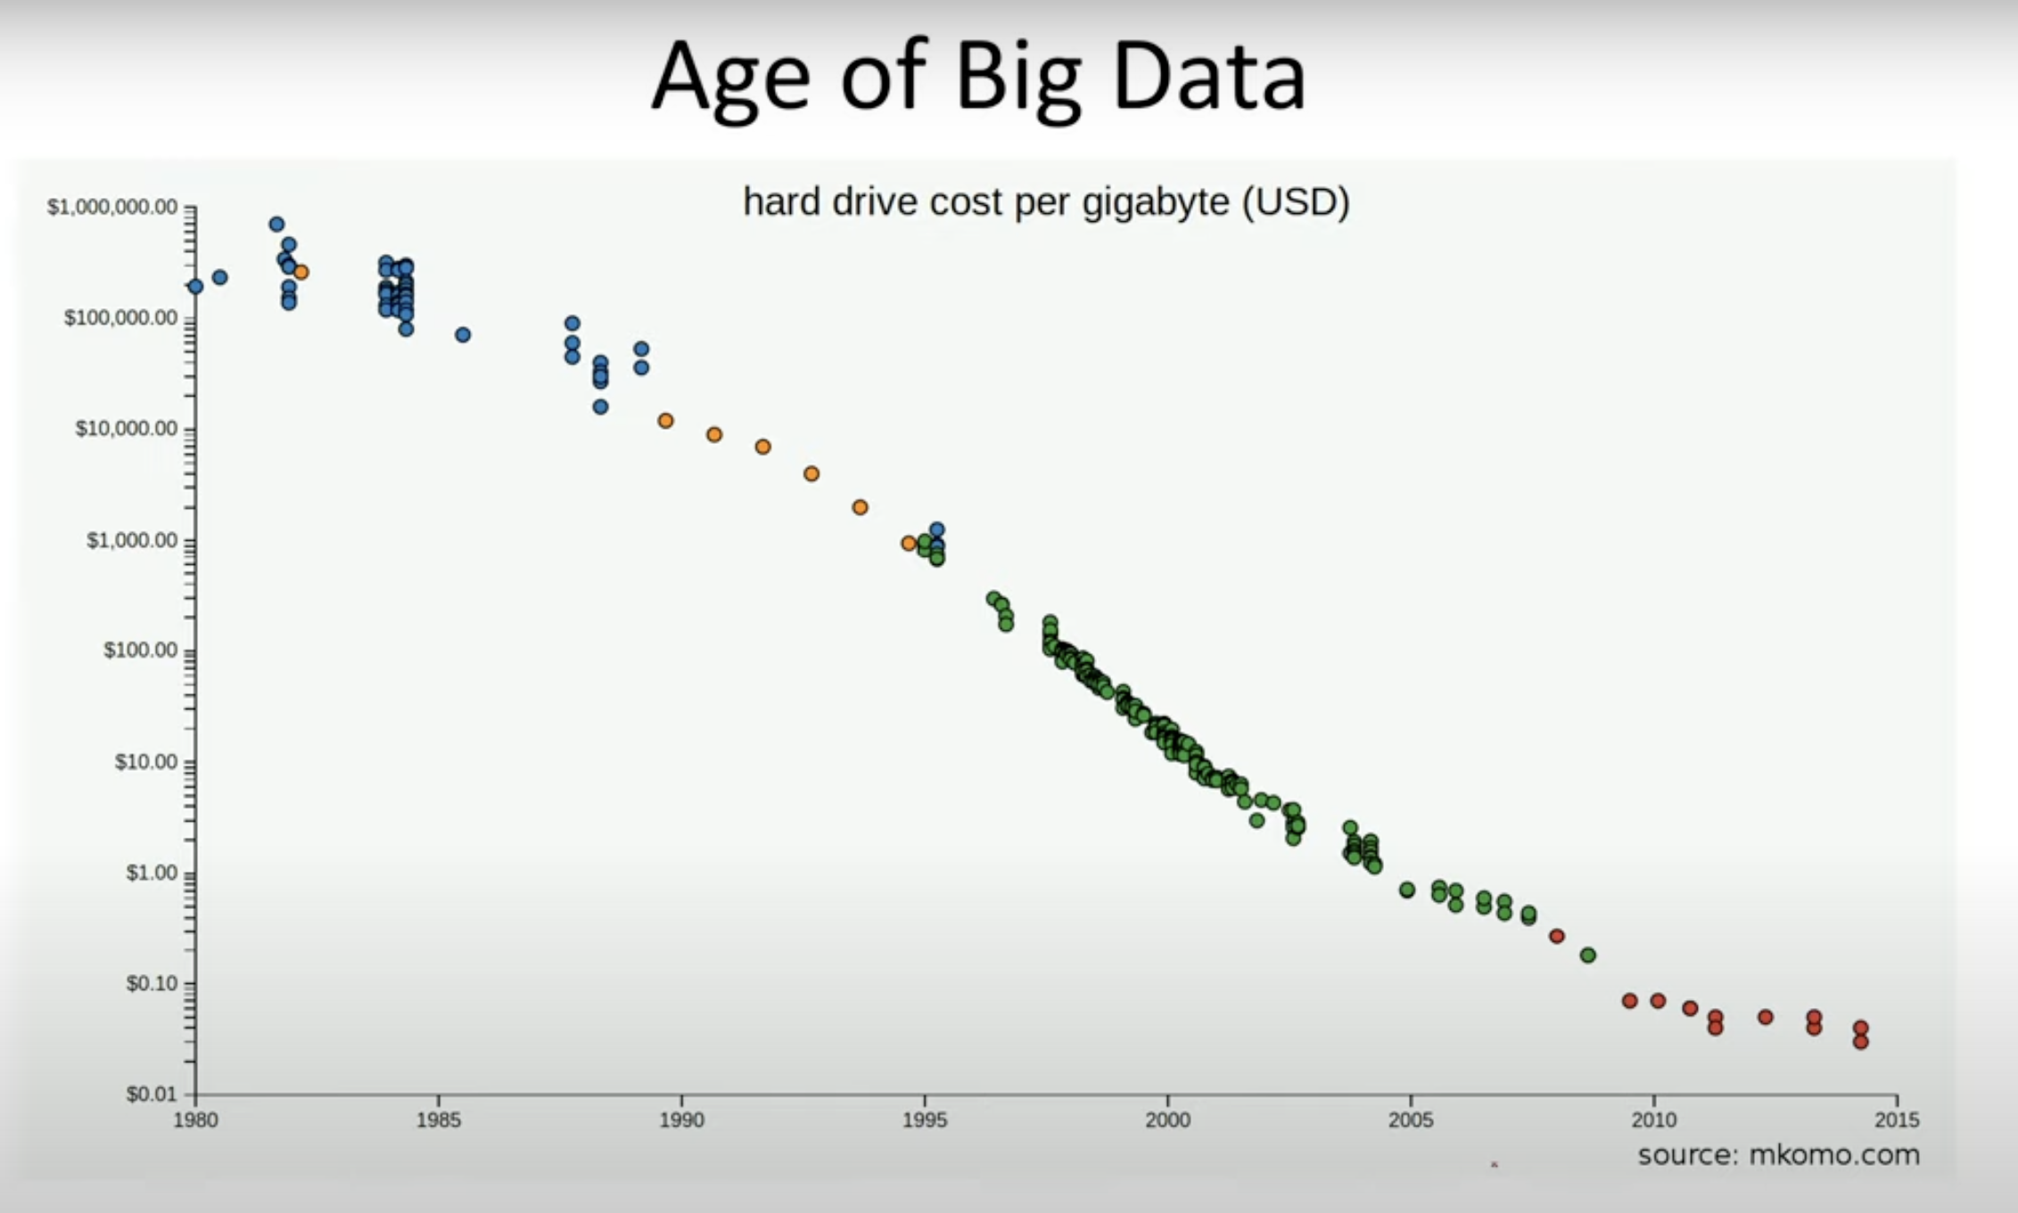
Notes:
increasing capability to store data economically

Slide 25
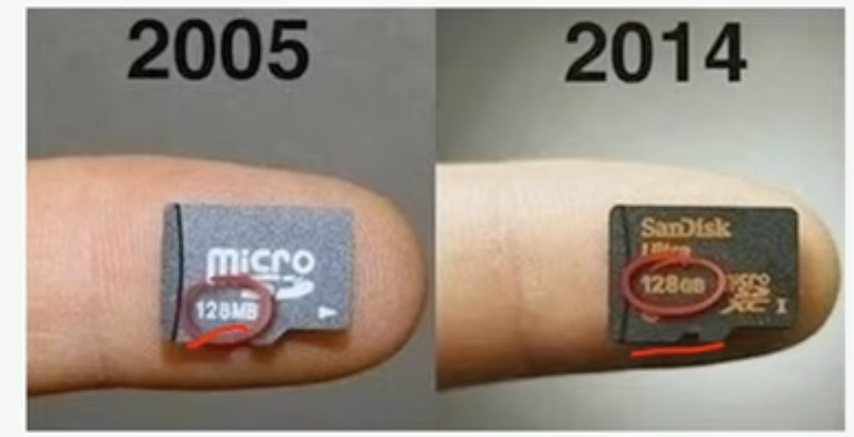


Slide 26
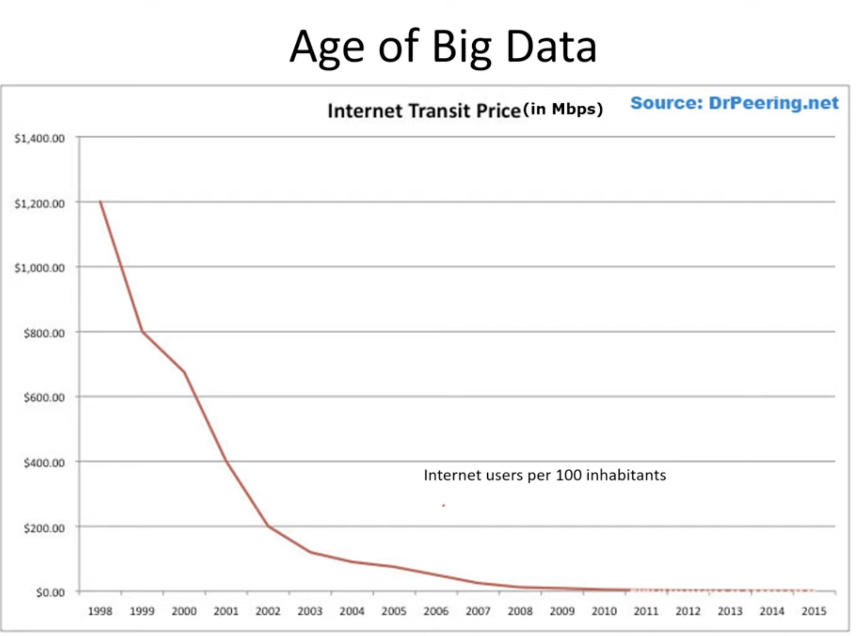

Slide 27
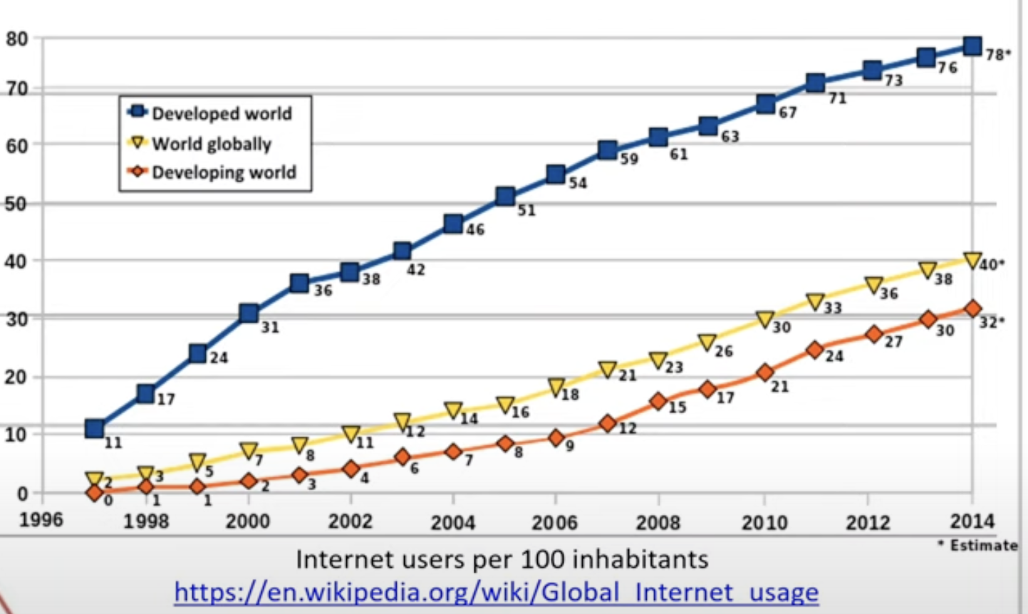

Slide 28
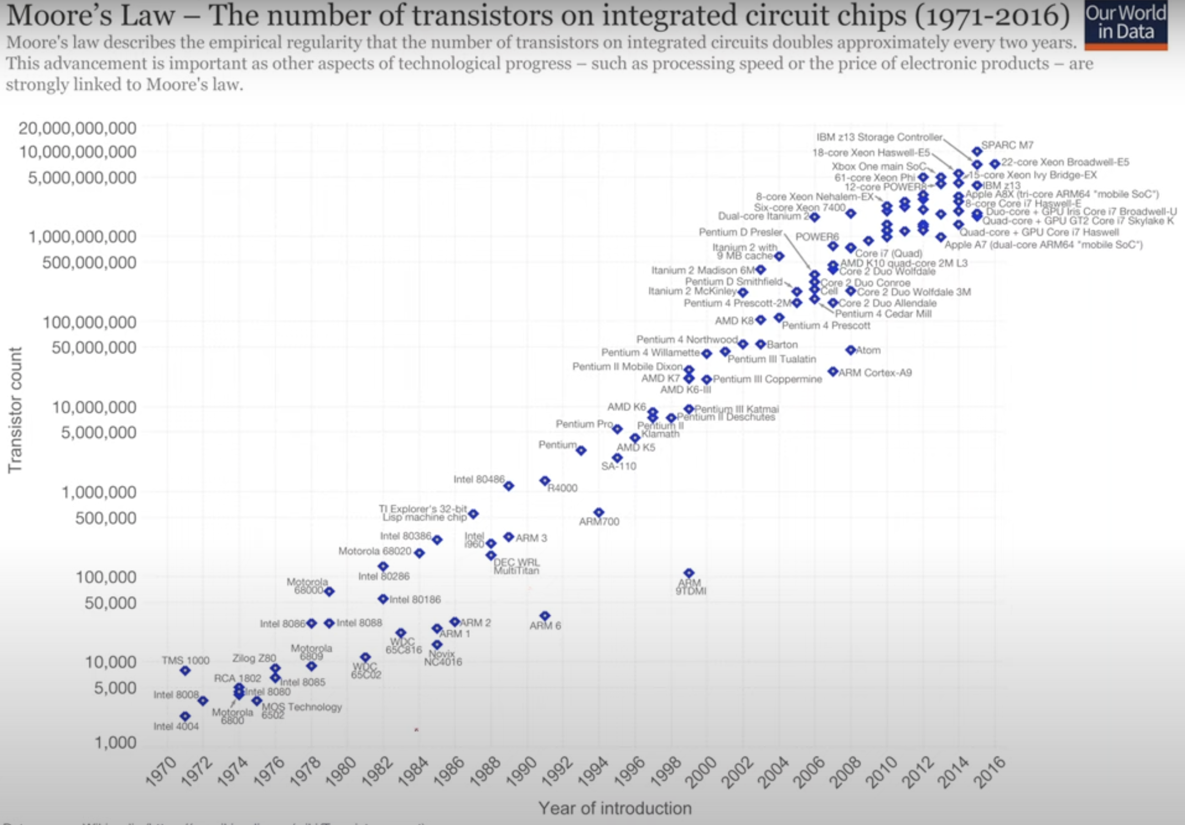
Notes:
capability of processing the data has increased
capability to have more storage
we have super computers
we have GPUs

Slide 29

Introduction
If we look around us we will find data being recorded in all its forms.
Wall-Mart with 4000 stores, has to deal with 460 terabytes+ database.
1 terabyte ~ two million books
Data collected in important strategic asset
BI hidden.
In reality, only a small amount of these data will ever be used.
Why?
Drowning in data and starving for information.

Slide 30
What is Data Mining?
“There are things that we know that we know
There are things that we know that we don’t know
There are things that we don’t know we don’t know.”
Donald Rumsfield
Ex-US Secretary of Defense

Slide 31
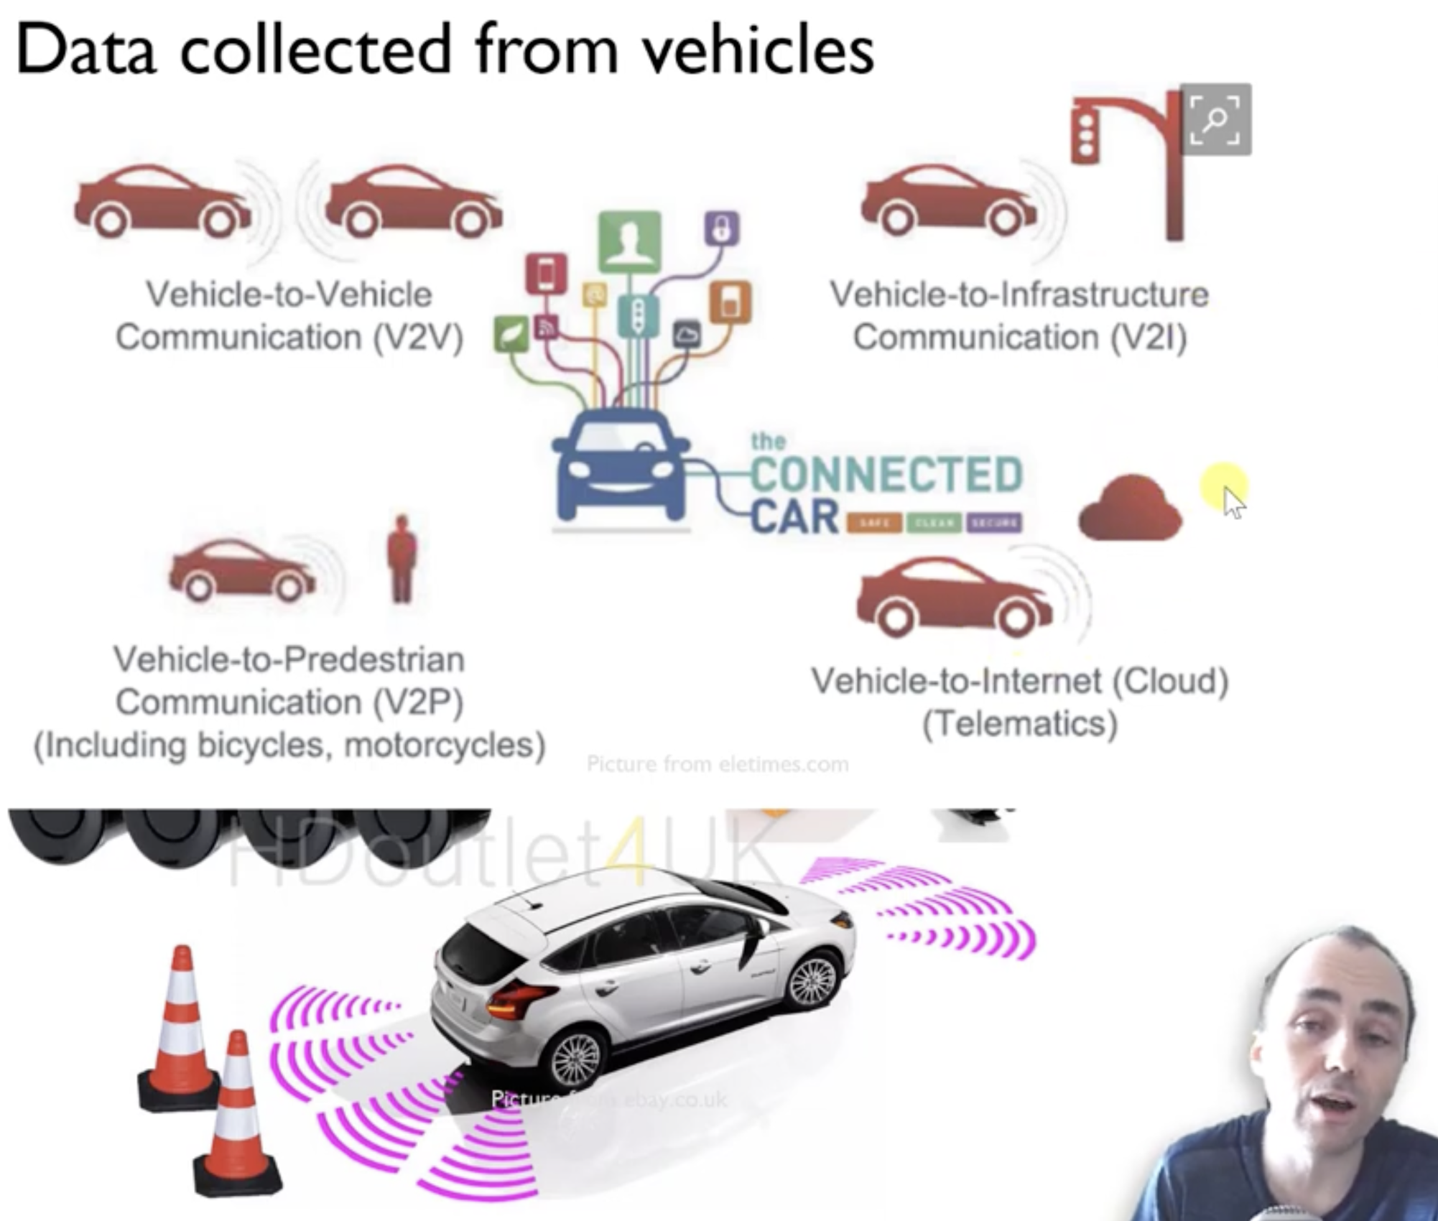

Slide 32

Internet of Things
Different objects can communicate and exchange data
~30 billion connected objects in 2020 (Nordum 2016)
This Photo by Unknown Author is licensed under CC BY-SA-NC

Slide 33
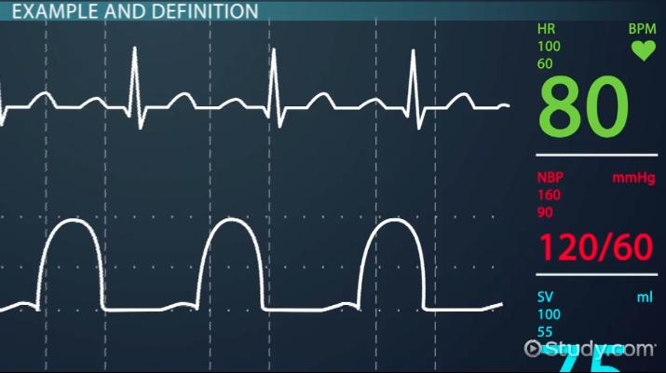
Data collected from humans
Movement
Brain Signals
Skin Conductivity
Hear Rate
Blood Pressure
Eye Movement
Spatioal Locations
……..

Slide 34
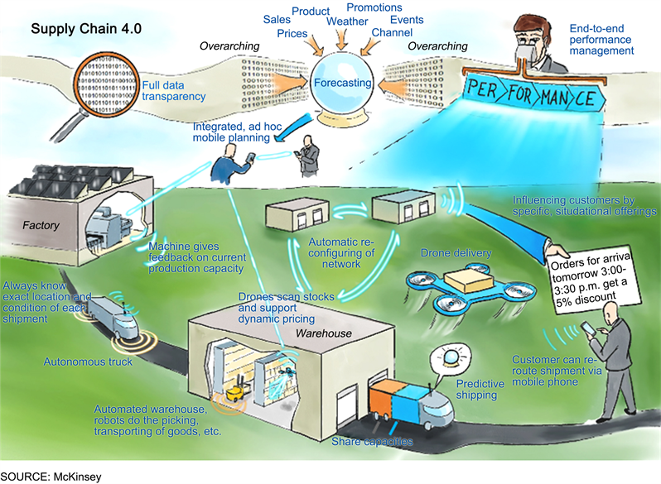
Data Collected from the industry
Internal Data
Data about employees, customers market etc.
Banking
Spending patterns, Income, social media
Retail Industry
Purchases, Reviews of products, customer behavior, surverys, advertisement campaign data ….
This Photo by Unknown Author is licensed under CC BY

Slide 35
What to do with all this Data ???
Having a lot of data is great
But we want to be able to understand the data
We also want to discover new knowledge that can help us understand the data and support decision making
If we cannot do that, the data is useless

Slide 36
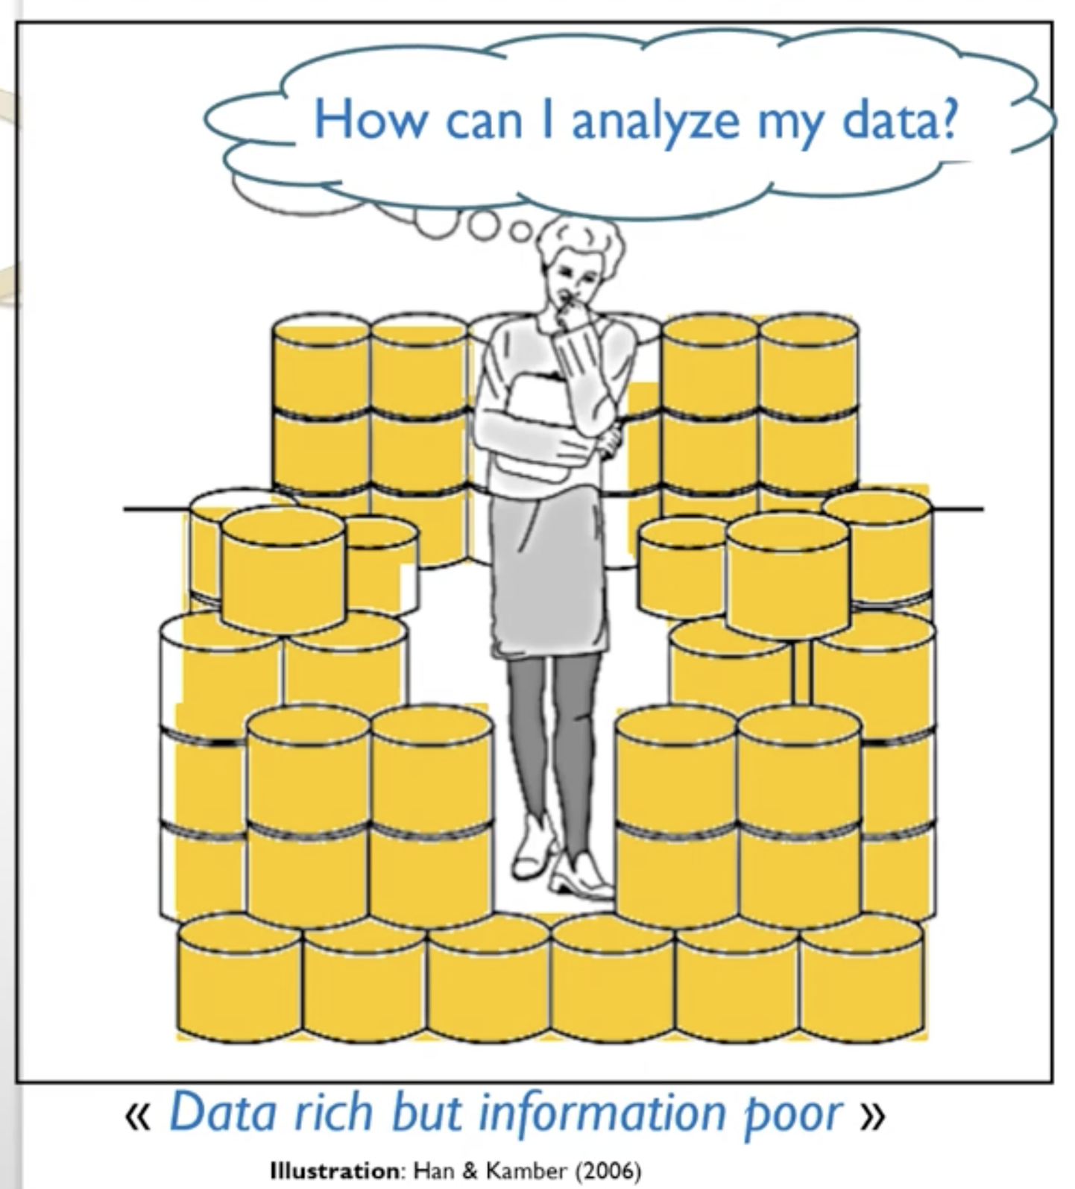
Analyzing data by hand?
time-consuming
may miss important information
Nor suitable for “big data”

Slide 37
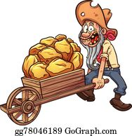
What is data mining ?
Data Mining consists of techniques to automatically discover interesting patterns in data (discover knowledge).
Two goals:
Understand the past
e.g. Why there was an earthquake last year ?
Predict the future
e.g. Will there be an earthqake tomorrow?
e.g. Will this customer pay back his debt ?
This Photo by Unknown Author is licensed under CC BY

Slide 38
Data Mining Definition
What is definition?
Extraction of non-trivial, implicit, previously unknown and potentially useful information or patterns from data.
Other names:
Knowledge discovery(mining) in databases (KDD),
Business intelligence, etc.
Notes:
non-trivial -> significant
Implicit -> not directly expressed

Slide 39
Dataset size
Can be applied on small sized datasets
Preferably use large datasets
Why?
Need Confidence + Validation
Notes:
More data increases the probability that it contains useful information, which is advantageous.

Slide 40
What is Data Mining?
Tell me something that I don’t know.
When you don’t know what you should be knowing, how do you write SQL?
You cant!!

Slide 41
Steps of KDD (1)
Learning the application domain:
relevant prior knowledge and goals of application
Creating a target data set: data selection
Data cleaning and preprocessing: (may take 60% of effort!)
Data reduction and transformation:
Find useful features, dimensionality/variable reduction, invariant representation

Slide 42
Steps of KDD (2)
Choosing functions of data mining
summarization, classification, regression, association, clustering.
Choosing the mining algorithm(s)
Data mining: search for patterns of interest
Pattern evaluation and knowledge presentation
visualization, transformation, removing redundant patterns, etc.
Use of discovered knowledge

Slide 43
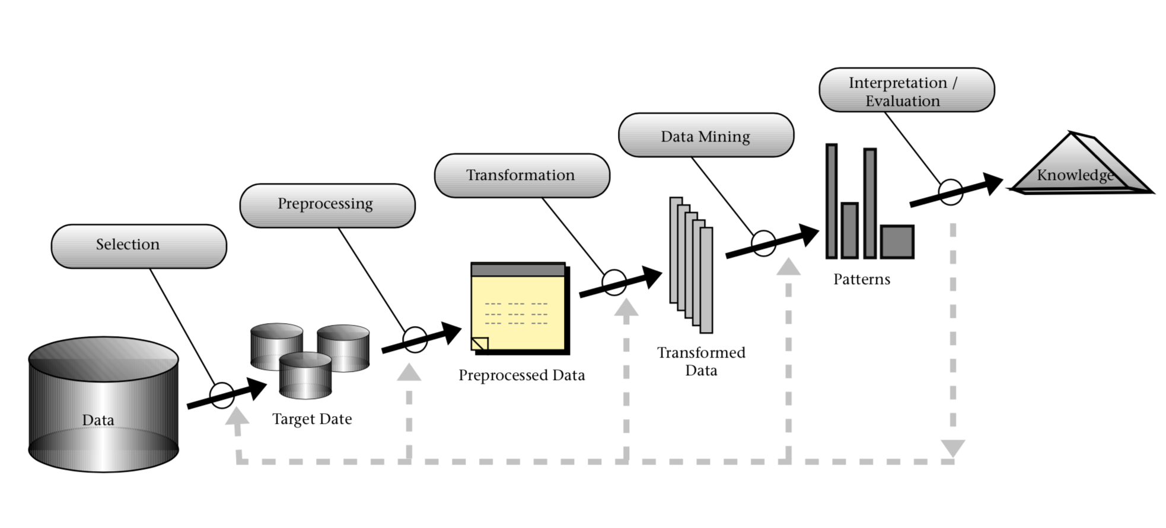
Data Mining: A KDD Process
This Photo by Unknown Author is licensed under CC BY-NC

Slide 44
Market Basket Analysis
Where are the data sources for analysis?
Credit card transactions, loyalty cards, discount coupons, customer complaint calls, plus (public) lifestyle studies
Target marketing
Find clusters of “model” customers who share the same characteristics: interest, income level, spending habits, etc.
Determine customer purchasing patterns over time
Conversion of single to a joint bank account: marriage, etc.

Slide 45
Market Basket Analysis
Cross-market analysis
Associations/co-relations between product sales
Prediction based on the association information
Customer profiling
data mining can tell you what types of customers buy what products (clustering or
classification)
Identifying customer requirements
identifying the best products for different customers use prediction to find what
factors will attract new customers
Provides summary information
various multidimensional summary reports statistical summary information (data
central tendency and variation)

Slide 46
Fraud Detection
Applications
widely used in health care, retail, credit card services, telecommunications (phone card fraud), etc.
Approach
use historical data to build models of fraudulent behavior and use data mining to help identify similar instances
Examples
Auto insurance: detect a group of people who stage accidents to collect on insurance
Money laundering: detect suspicious money transactions (US Treasury's Financial
Crimes Enforcement Network)
Medical insurance: detect professional patients and ring of doctors and ring of
references

